Slide 1
Hashing
Notes:
This lecture introduces a technique called hashing that ideally can result in Order of at most (1) search times.

Slide 2
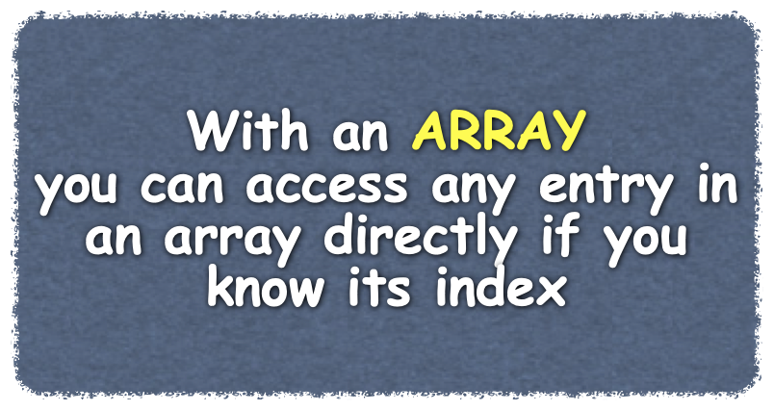




Hashing
Can result in O(1) search times
Cannot provide traversals of search keys is sorted order
Determines index of an entry using only search key
Does not search for item
Hash Table
Array storing values indexed by a hash function
Hash Function
Takes search key and produces index of element in the hash
Algorithm add(key, value)
index = hash(key)
hashTable[index] = value
Algorithm getValue(key)
index = hash(key)
return hashTable[index]
hash(555-1234) => 5
150 Main Street
0 | 1 | 2 | 3 | 4 | 5 | 6 | 7
Notes:
Because searching databases is such a widespread application of computers, the dictionary is an important abstract data type. The implementations that we discussed in the previous lectures are fine for certain applications, but for others they are inadequate. For example, if locating data is critical, even an Order of at most (log n) search can be too slow. Such is the case for the emergency telephone (911) system. If you call 911 from a land line, your telephone number is the key in a search of a dictionary of street addresses. Obviously, you want this search to find your location immediately! Hashing can be an excellent choice for implementing a dictionary when searching is the primary task.
@@ But as good as hashing can be, it is not always appropriate. For example, hashing cannot provide a traversal of the search keys in sorted order. Later in this book we will consider other implementations of the ADT dictionary. Do you spend time looking for your keys in the morning? Or do you know exactly where they are? Some of us spend too much time sequentially searching our unsorted possessions. Others have a special place for things and know just where to find each one. -- An array can provide a place for a dictionary’s entries.
@@ Admittedly, arrays have their disadvantages, but you can access any entry in an array directly if you know its index. No other array entry need be involved.
@@ Hashing is a technique that determines this index using only an entry’s search key, without searching.
@@ The array that stores values is called a hash table.
@@ A hash function takes a search key and produces the integer index of an element in the hash table. This array element is where you would either store or look for the search key’s associated value. For example, the 911 emergency system can take your telephone number, convert it to a suitable integer i, and store a reference to your street address in the array element [i]. We say that the telephone number—that is, the search key—maps, or hashes, to the index i. This index is called a hash index. Sometimes we will say that the search key maps, or hashes, into the table location at the index i.
Let’s look at a quick example of how hashing works
@@ We’ll use this array as our hash table. It stores the address of everyone in our 911 calling area. The search key is the telephone number of the person calling. If someone calls us, to find the index of the array element containing the person’s address
@@ We pass the telephone number to our hash function. This function translates or maps the phone number to an integer that we use as an index into the has table
@@ to retrieve the person’s address.
@@ a simple algorithm that uses a hash function to add an entry to our collection might look like this where we find the index by sending the hash function the search key, and then add the value at the that location in the has table
@@ to retrieve a value stored in the hash table, we would again use call the hash function and send it the search key to find the index of the value. We can then return the entry stored at that element in the hash table.
The hash function is an important part of this process so let’s look at it closer.

Slide 3

Hash Functions
Perfect Hash Function
Maps each search key into a different integer that is suitable as an index to the hash table
Sparse Hash Table
Only a few elements in hash table are in use
Typical Hash Function
Convert the search key into hash code
Compress hash code into range of hash table
Collision
Hash function returns the same hash code for two different search keys
Our small town has 700 residents
All telephone numbers are part of the 555 exchange
Simple hash for our telephone numbers:
return the 4-digit extension
hash(555-1234) => 1234
Requires a hash table of 10,000 elements
Hash value range : 0000 - 9999
Table will be sparse
9,300 elements will not be used
Algorithm getHashIndex(phoneNumber) // Returns an index to an array
// of tableSize locations.
i = last four digits of phoneNumber return i % tableSize
getHashIndex(555-0721) => 21
getHashIndex(555-2121) => 21
Notes:
A perfect hash function maps each search key into a different integer that is suitable as an index to the hash table. For example, if our hash table had 1000 elements, a perfect hash function would would map up to a thousand search keys to the 1000 elements in the hash table. Normally, a perfect hash function is only possible if the number of unique search keys is the same as the number of elements in the hash table.
@@ What is more common is a sparse hash table - a hash table where only a few elements are in use. This avoids the possibility that two search keys map to the same element in the hash table, but it also wastes space.
@@ LEt’s look at an example --- Our small town has 700 residents
@@ All telephone numbers are part of the 555 exchange
@@ Simple hash for our telephone numbers: returns the 4-digit extension - for example hash(555-1234) => 1234. This hash function returns a unique integer value for each telephone number.
@@ Requires a hash table of 10,000 elements since our Hash value range is from 0000 to 9999
@@ Table will be sparse since 9,300 elements will not be used.. If our town only has 700 residents, we don’t need a has table with 10,000 elements, only 700 would suffice. If we could compress the 10,000 possible values down to 700, we could use a 700 element has table.
@@ one way to do this is to take the last four digits of the telephone number modulo 70 for the 700 residents. That works well for now, but later, we’ll look at some issues with this algorithm
@@ Or hash function looks like a typical hash function. First, the search key is converted in to an integer called a hash code.
@@ Then the hash code is compressed into the range of indices for the hash table.
@@ One of the problems with the compression step of the hash function is that it is possible for two search keys to have the same hash code - this is called a collision.
@@ For example, using our hetHashIndex function, the hash code of 555-0721 is 21.
@@ The hash code of 555-2121 is also 21. - We have a collision. We will discuss how to handle collisions in a future lecture.

Slide 4
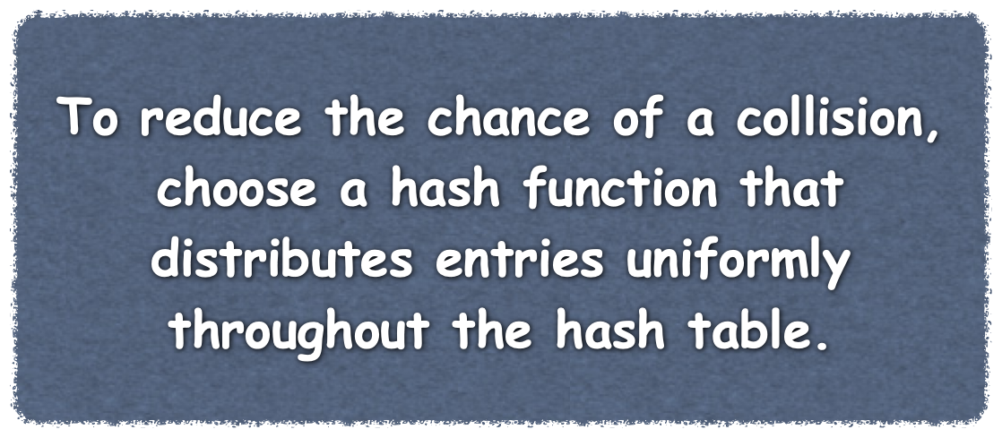
Hash Functions
A good hash function
Minimize collisions
Be fast to compute
HashedDictionary.h
// Create a hash function type called hashFunction that hashes "KeyType"
// First we create an an unordered_map object for our KeyType and ItemType
std::unordered_map<KeyType, ItemType> mapper;
// Then we call the hash_function method to return the hash function
// for the KeyType and assign it to 'hashFunction'
typename std::unordered_map<KeyType, ItemType>::hasher hashFunction = mapper.hash_function();
HashedDictionary.cpp
int HashedDictionary<KeyType, ItemType>::getHashIndex(const KeyType& itemKey) const
{
// static_cast needed since the hasFunction returns an unsigned long
return static_cast<int>(hashFunction(itemKey) % hashTableSize);
} // end getHashIndex
Notes:
Any function can be a hash function if it produces an integer that is suitable as an array index. But not every such function is a good hash function. A good hash function should Minimize collisions and be fast to compute. Remember that a typical hash function first converts a search key to an integer hash code. The hash function then compresses the hash code into an integer that is suitable as an index to the particular hash table. To reduce the chance of a collision after compression, choose a hash function that distributes entries uniformly throughout the hash table.
A perfect hash function would require that unequal objects have distinct hash codes. In general, however, unequal objects might have the same hash codes. Since duplicate hash codes lead to collisions, you want to avoid this situation when possible.
@@fast to compute -- Tech Report 1, C11
@@
@@

Slide 5

Hash Functions
A good hash function
Minimize collisions
Be fast to compute
Hash Codes for Strings
Convert characters to Unicode integers
Multiply characters based on position in string
Hash Codes for Primitive Types
Cast it to an int
byte, short, or char
Manipulate internal representations
Perform folding
Divide key into parts
Recombine and process parts
Algorithm hashCode(someString) int hash = 0; int n = someString.length(); for (int i = 0; i < n; i++)
hash = g * hash + someString[i];
// The Java String class uses g = 31
Notes:
Search keys are often strings, so generating a good hash code from a string is important. Typically, you begin by assigning an integer to each character in the string. For example, you could assign the integers 1 through 26 to the letters “A” through “Z” and the integers 27 through 52 to the letters “a” through “z.” However, using a character’s Unicode integer is more common and actually easier to do. Suppose that the search keys for a telephone directory are names such as Brett, Carol, Gail, and Josh. You can compute hash codes for these names in several ways. For example, you could take the Unicode value of the first letter in each name and get distinct hash codes. But if several names begin with the same letter, their hash codes will be the same if you use this scheme. Since the letters that occur in any one position of a name do not occur with equal probability, a hash function that uses any particular letter will not distribute the names uniformly throughout the hash table.
Suppose that you sum the Unicode values for each letter in the search key. In an application where two different search keys never contain the same letters, this approach can work. But if your search keys are airport codes, for example, DUB and BUD would have the same hash code. This approach also can restrict the range of the hash codes, since the Unicode values for letters lie between 65 and 122. Thus, three-letter words would map into values between 195 and 366 under this plan.
@@A better approach to generating a hash code for a string involves multiplying the Unicode value of each character by a factor based on the character’s position within the string. The hash code is then the sum of these products. Here a common hash function for a string. g is some positive constant and this function results in a polynomial in g., This has function is also the algorithm used by Java’s implementation of the hashCode method for the String class. Java uses a value of 31 for g.
@@If the search key’s data type is int, you can use the key itself as the hash code. If the search key is an instance of either byte, short, or char, you can cast it to an int to get a hash code. Thus, casting to an int is one way to generate a hash code.
@@ For other primitive types, you manipulate their internal binary representations. If the search key is an integer of type long, it contains 64 bits. An int has 32 bits. Simply casting the 64-bit search key to an int—or performing a modulo 2³²—would lose its first 32 bits. As a result, all keys that differ in only their first 32 bits will have the same hash code and collide. For this reason, ignoring part of a search key can be a problem. Instead of ignoring a part of a long search key, divide it into several pieces. Then combine the pieces by using either addition or a bit-wise boolean operation such as exclusive or. This process is called folding.

Slide 6
Hash Functions
Compressing a Hash Code
Use modulo operator %
(hashCode) % (hash table size)
c % n
n should be odd
Ideally, n should be prime
int getHashIndex(KeyType searchKey)
{
int hashIndex = getHashIndex(searchKey) % hashTableSize;
if (hashIndex < 0)
hashIndex = hashIndex + hashTableSize;
return hashIndex;
} // end getHashIndex
Notes:
The most common way to scale an integer so that it lies within a given range of values is to use the modulo % operator. For a positive hash code c and a positive integer n, c % n divides c by n and takes the remainder as the result. This remainder lies between 0 and n - 1. Thus, c % n is ideal for the index of a hash table that has n locations.
@@ So, n should equal the size of the hash table, but not any n will do. For example, if n is even, c % n has the same parity as c—that is, if c is even, c % n is even; if c is odd, c % n is odd. If the hash codes are biased toward either even or odd values (and note that hash codes based on memory addresses are typically even), the indices to the hash table will have the same bias. Instead of a uniform distribution of indices, you will leave out the indices of many table locations if n is even. Thus, n—the size of the hash table—always should be an odd number.
@@ When n is a prime number—one that is divisible only by 1 and itself— c % n provides values that are distributed throughout the index range 0 through n - 1. All Prime numbers—with the exception of 2—are odd.
One final detail remains. It is possible a hashCode function might return a negative integer, so you need to be a bit careful. If c is negative, c % n lies between 1 − n and 0. A zero result is fine, but if c % n is negative, add n to it so that it lies between 1 and n − 1.
@@ We now can implement our own hash function for the ADT dictionary. HEre is a method computes the hash index for a given search key whose data type is the KeyType. The data field hashTable is the array that serves as the hash table. hashTableSize is the size of the array, not the number of current entries in the hash table. We assume that this size is a prime number and that the method hashCode returns a hash code consistent with our requirements

Slide 7
Hashing
Notes:
This lecture introduces a technique called hashing that ideally can result in Order of at most (1) search times.

Slide 8

Resolving Collisions
Change structure of has table
Each location can represent more than a single value
Use another location in the hash table
Open Addressing
Probing
Locating an open location in hash table
Linear Probing
Sequentially searching for an open element
555-0721
555-2121
150 Main Street
95 Tent Avenue
getHashIndex(555-0721) => 21
getHashIndex(555-2121) => 21
555-2121
95 Tent Avenue
555-0721
150 Main Street
20 | 21 | 22 | 23 | 24 | 25 | 26 | 27
Notes:
Now lets examine how we can resolve collisions
When adding to a dictionary, if our hash function maps a search key into a location in the hash table that is already in use, we need to find another spot for the search key’s value. We have two fundamental choices:
•Change the structure of the hash table so that each array location can represent more than
one value
@@ Use another location in the hash table
Finding an unused, or open, location in the hash table is called open addressing. This choice sounds simple, but it can lead to several complications. Changing the structure of the hash table is not as difficult as it might sound and can be a better choice for resolving collisions than using an open addressing scheme. We will with a simple example of open addressing.
@@ here are two entries that we wish to store in our hash table
@@ for the first, our has function returns the value 21,
@@ so we store the value in array element 21.
@@ For the second entry we wish to add, our hash function returns the same index - 21 What should we do?
@@ a simple solution is to perform probing - look for an open element. IF we sequential search for an element, that is look at hash table element location 22 next, this is referred to as linear probing.
@@ in this case, element 22 is available, so we add the value at this location. Then if another search key returns either 21 or 22, we would store is in element 23 since that is the next available hash table location
A problem arrives when we go to retrieve the value associated with the telephone number 555-2121 - our hash function sends us to 21, but the entry at 21 is the value associated with the search key 555-0721. How do we know to look at the next location for our value?
@@ when using open addressing, or most collision resolution algorithms, we must store the search key along with the value in the hash table. We can then compare the search found at the hash table location with the search key we were given. If it does not match, we continue on to the next entry in the table until either we find a match or an empty element. So we are sequentially searching for the search key, but the range of elements to search is relatively small.
While open addressing is simple, conceptually, it is difficult to implement reliably -
@@ for example, if we now remove the entry at hash table element 21, how do we ensure searches find the value stored at element 22 that has a hash index of 21? Should we move the entry at element 22 to element 21? What if it’s hash index was actually 22?
There are number of solutions to these questions, but we won’t cover them here.
Let’s move on to the idea of changing the structure of the table . . .

Slide 9
Resolving Collisions
Separate Chaining
Each hash table element is a bucket
Place matching hash indices in the same bucket
Where to insert new entries
555-0721
555-2121
150 Main Street
95 Tent Avenue
getHashIndex(555-0721) => 21
getHashIndex(555-2121) => 21
/
95 Tent Avenue
key
next
555-2121
value
Search Keys | Where to insert
Unsorted duplicate | Beginning of chain
Unsorted distinct | End of chain
Sorted distinct | In sorted order
150 Main Street
key
next
555-0721
value
20 | 21 | 22 | 23 | 24 | 25 | 26 | 27
Notes:
A second general approach to collision resolution alters the structure of the hash table so that each location can represent more than one value. Such a location is called a bucket. Anytime a new search key maps into a particular location, you simply place the key and its associated value in the bucket, much as we did with open addressing. To find a value, you hash the search key, locate the bucket, and look through the key-value pairs in it. In all likelihood, the bucket contains few values, so this mini-search will be fast. When you remove an entry, you find it in its bucket and delete it. Thus, the entry no longer exists in the hash table.
What can you use to represent a bucket? A list, a sorted list, a chain of linked nodes, an array, or a vector are some possibilities with which you are familiar. Anything that involves an array or vector will cause a substantial memory overhead, since each location in the hash table will have a fixed amount of memory allocated to it. Much of this memory will be unused.
@@ Either a linked implementation of a list or a chain of linked nodes is a reasonable choice for a bucket, since memory is allocated to the bucket only as needed. In this arrangement, each location in the hash table is a head reference to a chain of linked nodes that make up the bucket. Each node contains references to a search key, to the key’s associated value, and to the next node in the chain. Notice that a node must reference the search key so that you can locate it later when you search the chain. Resolving collisions by using buckets that are linked chains is called separate chaining.
@@ Where in the chain we should insert entries with duplicate hash indices depends on how we are implementing our dictionary.
@@ If we have a dictionary that allows duplicate search keys, adding a new entry to the beginning of the correct chain is fastest
@@ However, if we want distinct search keys, adding a new entry requires us to search a chain for the search key. If we don’t find it, we will be at the end of the chain, where we can add the new entry.
@@ But since we have to search the chain anyway, you could maintain the chain in sorted order by search key. Subsequent searches would then be a little faster. Typical chains are short, so this refinement might not be worth the effort.

Slide 10
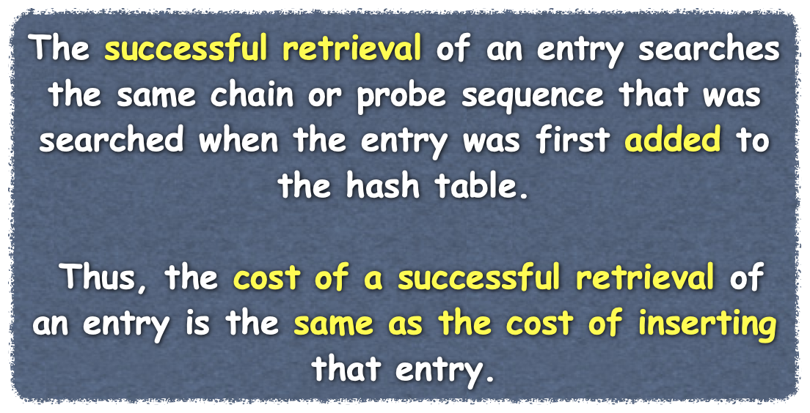
Efficiency of Hashing
Assuming distinct search keys
Searching for keys is used by
add method ensures duplicates do not occur
remove method to find the entry to remove
getValue method to find the value to return
General observations on dictionaries that use hashing
Successful retrieval or removal has the same efficiency as a successful search
An unsuccessful retrieval or removal has the same efficiency as an unsuccessful search
A successful addition has the same efficiency as an unsuccessful search
An unsuccessful addition has the same efficiency as a successful search
Notes:
Now let’s examine the efficiency of hashing. As you saw in a previous lecture, implementations of the ADT dictionary depend on whether the dictionary requires distinct search keys. In this lecture, we consider only dictionaries with distinct search keys.
@@ When the search keys are distinct, the add method for the dictionary must ensure that duplicate search keys do not occur.
Each of the dictionary operations getValue, remove, and add searches the hash table for a given search key. The success or failure of a search for a given key directly affects the success or failure of the retrieval and removal operations. The successful addition of a new entry occurs after a search for a given key fails. An unsuccessful addition replaces the value of an existing entry instead of adding a new entry. This operation occurs after a successful search for a given key.
@@ So, we have the following observations about the time efficiency of these operations:
• A successful retrieval or removal has the same efficiency as a successful search @@ An unsuccessful retrieval or removal has the same efficiency as an unsuccessful search
@@ A successful addition has the same efficiency as an unsuccessful search @@ An unsuccessful addition has the same efficiency as a successful search
So it is sufficient to analyze the time efficiency of searching the hash table for a given search key.

Slide 11

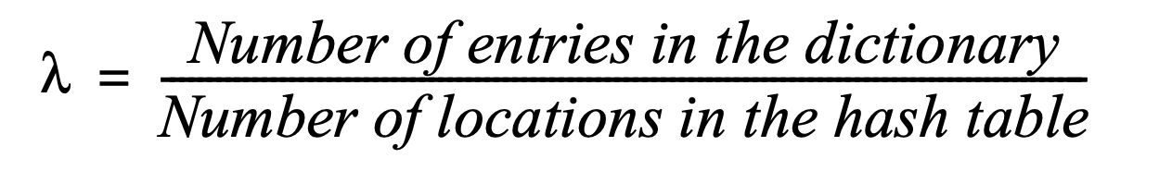
Load Factor
Perfect Hash Function
No collisions
Dictionary operations are O(1)
Resolving collisions takes time
As hash table fills, there are more collisions and operations take more time
Load Factor
How full the hash table is
About the Load Factor λ
λ is a measure of the cost of collision resolution
λ is never negative
Minimum of zero - empty hash table
for open addressing, λ does not exceed 1
for separate chaining, λ has no maximum value
restricting the size of λ improves the performance of hashing
Notes:
We started our discussion of hashing with a perfect hash function that caused no collisions. If you can find a perfect hash function for your particular set of search keys, using it to implement the ADT dictionary will guarantee add, remove and retrieval operations that are each Order of at most (1). Such an implementation is ideal. The good news is that finding a perfect hash function is quite feasible in certain situations. Unfortunately, using a perfect hash function is not always possible or practical. In those situations, collisions are likely to occur.
@@ Resolving a collision takes time and thus causes the dictionary operations to be slower than an Order of at most (1) operation. As a hash table fills, collisions occur more often, decreasing performance even further. Since collision resolution takes considerably more time than evaluating the hash function, it is the prime contributor to the cost of hashing.
@@ To help us express this cost, we define a measure of how full a hash table is. This measure—the load factor λ—is the ratio of the size of the dictionary to the size of the hash table.
Notice that λ is zero when the dictionary—and hence the hash table—is empty. The maximum value of λ depends on the type of collision resolution you use.
@@ For open addressing schemes, λ’s maximum value is 1 when the hash table is full. In that case, each entry in the dictionary uses one location in the hash table. Notice that the number of locations in the available state does not affect λ.
@@ For separate chaining, the number of entries in the dictionary can exceed the size of the hash table, so λ has no maximum value,
@@ but restricting the size of the load factor improves the performance of hashing

Slide 12
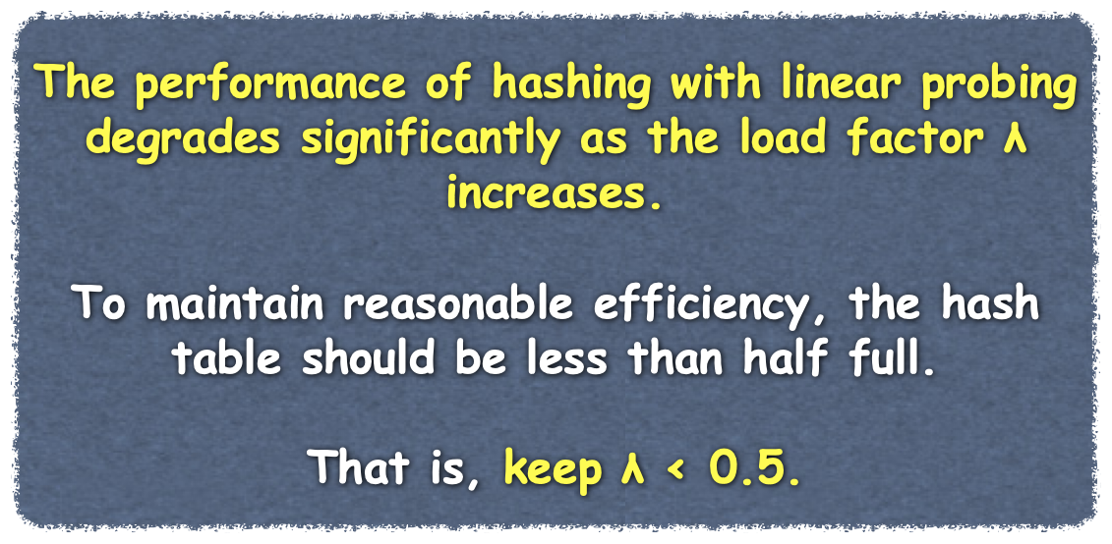

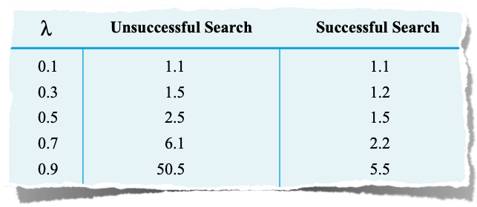
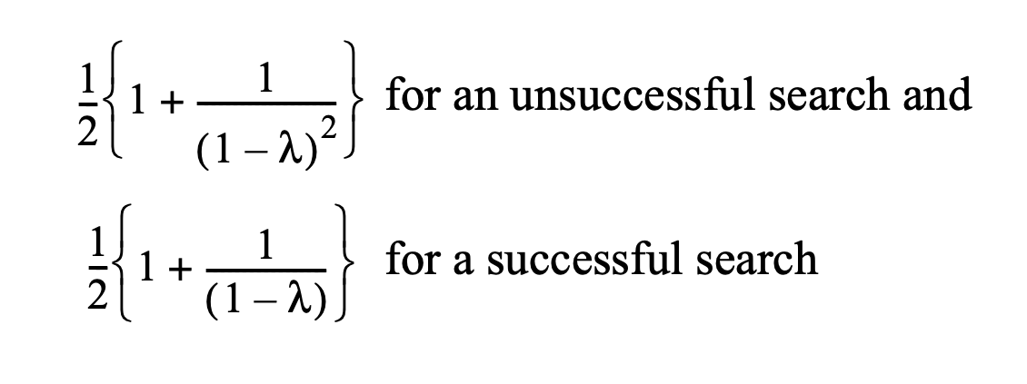
Load Factor
Cost of Open Addressing
Search probe sequence
Number of comparisons necessary to locate a search key in the hash table
Linear Probing
Collisions increase as the hash table fills
Average Number of Comparisons
To Search A Probe Sequence
Notes:
All open addressing schemes use one location in the hash table per entry in the dictionary. The dictionary operations getValue, remove, and add each require a search of the probe sequence indicated by both the search key and the collision resolution scheme in effect. Analyzing the efficiency of these searches is sufficient. @@ We’ll look at the number of comparisons necessary to locate a search key in the hash table. We’ll express these numbers in terms of the load factor λ. The derivations of these numbers are messy at best and in some cases difficult, so we’ll skip over them here. Interpreting the results, however, is straightforward. Recall that for open addressing, λ ranges from 0, when the table is empty, to 1 when it is full.
@@ When you use linear probing, more collisions will likely occur as the hash table fills. After a collision, you search a probe sequence that forms a cluster. If you add a new entry, the cluster grows in size. So you would expect the probe sequences to grow and, therefore, require longer search times.
@@ After some analysis. we can develop two equations that show the average number of comparisons needed to search the probe sequence for a given search key in both unsuccessful and successful searches. Keep in mind, that for an unsuccessful search, the entire probe sequence or cluster must be searched.
@@After evaluating these expressions for a few values of λ, we get the results in this table. As λ increases—that is, as the hash table fills—the number of comparisons for these searches increases. This result satisfies our initial intuition. For example, when the hash table is half full—that is, when λ is 0.5—an average unsuccessful search requires about 2.5 comparisons and an average successful search requires about 1.5 comparisons. As λ increases beyond 0.5, the number of comparisons for an unsuccessful search increases much more rapidly than for a successful search.
@@ Thus, performance degrades rapidly when the hash table is more than half full. Should this happen, you’d need to define a larger hash table, a process referred to as “Rehashing.”

Slide 13

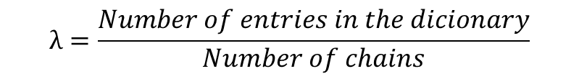

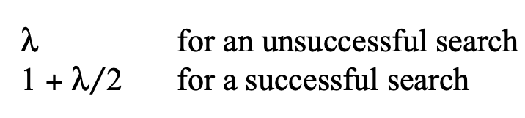
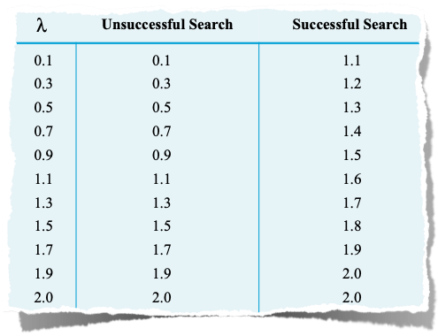
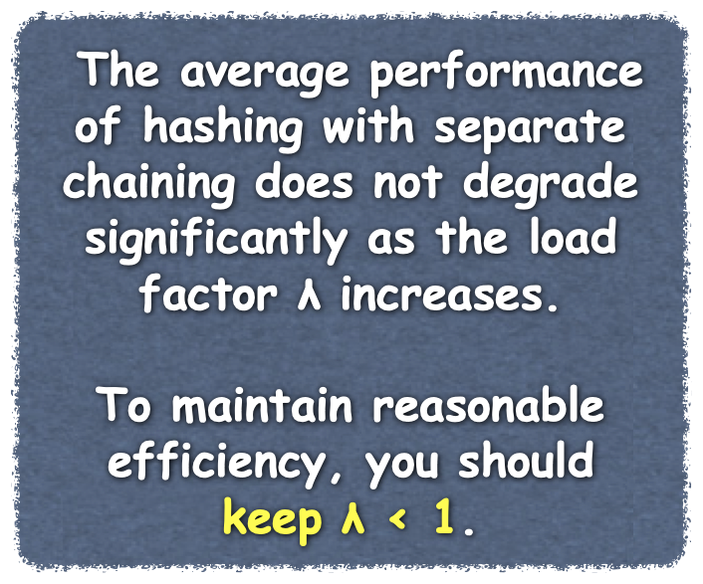
Load Factor
Cost of Separate Chaining
Number of chains is size of hash table
Operations need to search a chain with average length λ
Unsuccessful Searches
Empty Chain → O(1)
Non-empty Chain → λ
must search entire chain
Successful Searches
Always a non-empty chain
Must look at 1 + λ/2 entries on average
Average Number of Comparisons
To Search A Chain
Notes:
With separate chaining as the collision resolution strategy, each entry in the hash table can reference a chain of linked nodes. The number of such chains, including empty ones, is then the size of the hash table.
@@ Thus, the load factor λ is the number of dictionary entries divided by the number of chains. That is, λ is the average number of dictionary entries per chain. Since this number is an average, we expect some chains to contain fewer than λ entries—or even none—and some to have more. We’ll assume that the chains are not sorted and that the search keys in the dictionary are distinct.
@@ The dictionary operations getValue, remove, and add each require a search of the chain indicated by the search key. As was the case for open addressing, analyzing the efficiency of these searches is sufficient. Again, we will state the number of comparisons necessary to locate a search key in the hash table in terms of the load factor λ.
@@ An unsuccessful search of a hash table sometimes will encounter an empty chain, and so that operation is O(1) and would be the best case.
@@ But for the average case when the chains are not sorted, searching for an entry in the hash table without success examines λ nodes.
@@ In contrast, a successful search always inspects a chain that is not empty. In addition to seeing that the table location at the hash index is not null, an average successful search considers a chain of λ nodes and locates the desired entry after looking at λ/2 of them. Thus, the average number of comparisons during a search when separate chaining is used is about
λ for an unsuccessful search 1 + λ/2 for a successful search
@@ After evaluating these expressions for a few values of λ, we get the results in this table. The number of comparisons for these searches increases only slightly as λ increases—that is, as the hash table fills. @@ A typical upper bound for λ is 1, as smaller values do not provide significantly better performance.
@@ Notice the unusual result: Successful searches take more time than unsuccessful searches when λ < 2. Remember that these results are for the average case. In the worst case, all search keys map into the same table location. Thus, all entries occur in the same chain of nodes. The worst-case search time, then, is O(n), where n is the number of entries.

Slide 14
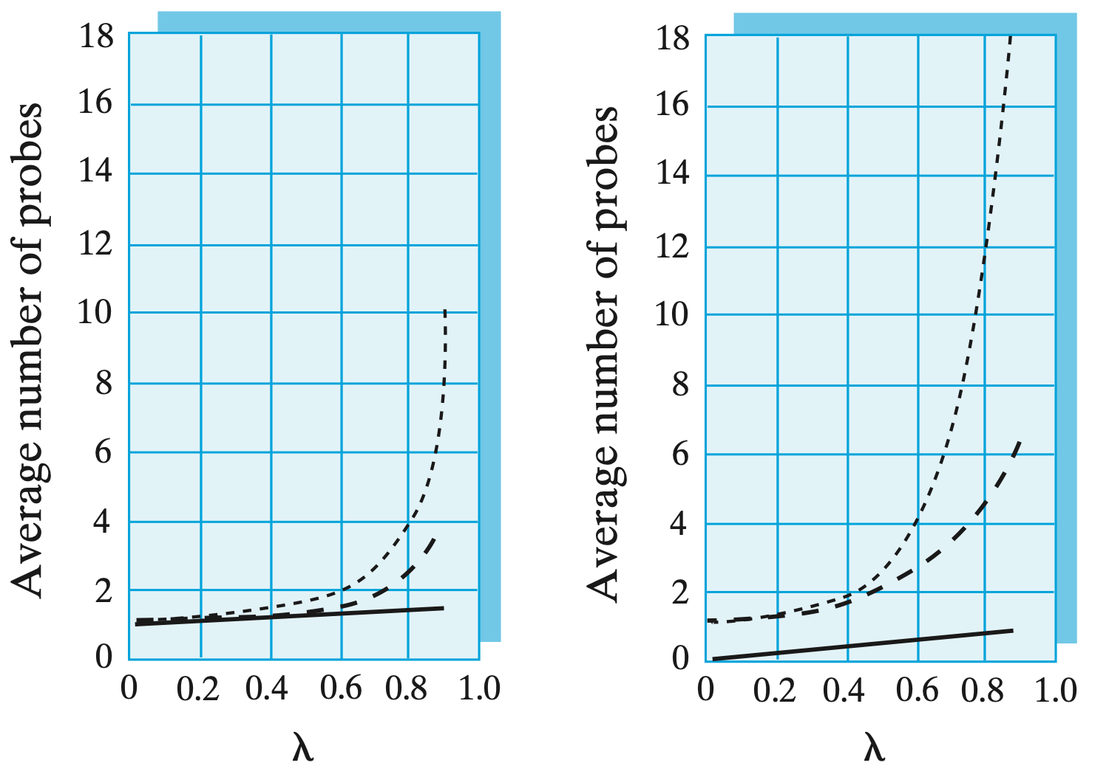
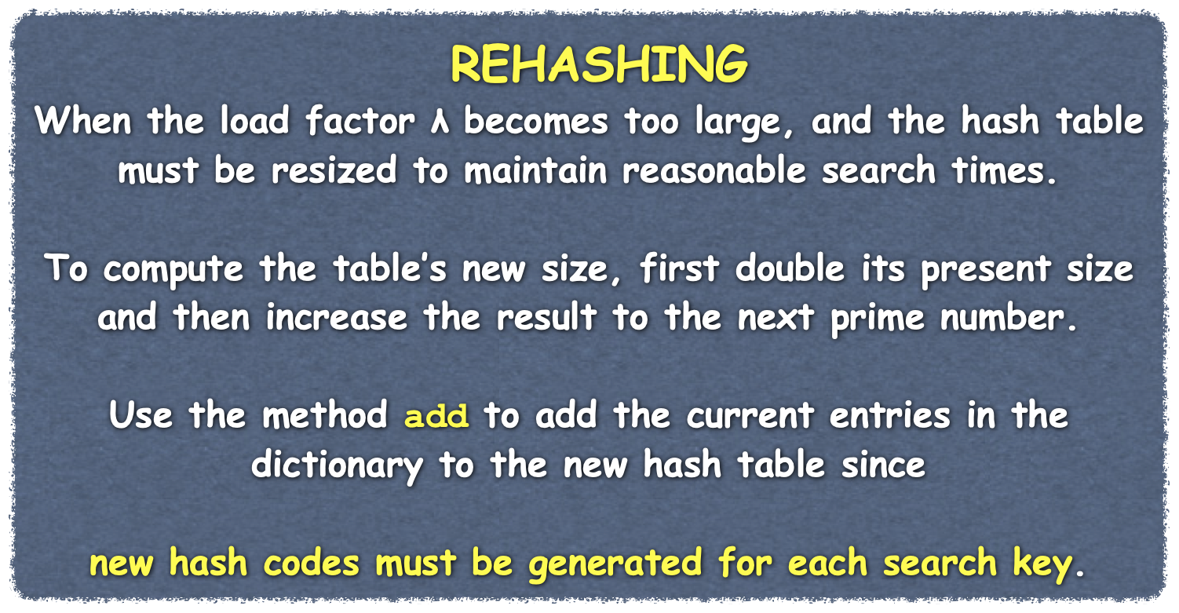
Efficiency of Hashing
Comparing Schemes for Collision Resolution
Separate Chaining is more time efficient
but requires more memory
Hash table can be smaller for separate chaining
Open addressing is more likely to lead to rehashing
Alternative is to use a large hash table
Successful Search
Unsuccessful Search
Linear Probing
Quadratic probing, double hashing
Separate Chaining
Notes:
Earlier, we saw how the load factor λ affects the average number of comparisons required by a search of a hash table for various ways to resolve collisions.
@@ The graphs shown here illustrate this effect for various collision resolution schemes.
@@ When λ is less than 0.5, the average number of comparisons for a successful search is about the same regardless of the process used to resolve collisions.
@@ For unsuccessful searches, the three open addressing schemes have about the same efficiency when λ is less than 0.5. However, separate chaining is somewhat more efficient in this case.
@@ As λ exceeds 0.5, the efficiency of open addressing degrades rapidly, with linear probing the least efficient. Separate chaining, on the other hand, remains efficient for values of λ up to 1. In fact, the tabulated data we looked at earlier shows that its efficiency degrades only slightly for λ between 1 and 2.
@@ Separate chaining certainly appears to be the fastest approach. But separate chaining can require more memory than open addressing, since each location in the hash table can reference a chain of linked nodes.
@@ On the other hand, the hash table itself can be smaller than when you use an open addressing scheme, since λ can be larger. Thus, space need not be a deciding factor in how you resolve collisions.
@@ If all of these collision resolution schemes used hash tables of equal size, open addressing would be more likely to lead to rehashing than separate chaining would.
Rehashing is When the load factor λ becomes too large, and the hash table must be resized to maintain reasonable search times. To compute the table’s new size, first double its present size and then increase the result to the next prime number. Use the method add to add the current entries in the dictionary to the new hash table since new hash codes must be generated for each search key.
@@To reduce the likelihood of rehashing, an open addressing strategy could use a large hash table. Remember that in Java, the table contains references that do not require much memory. So even though at least half of the table must remain unused, the actual space allocation would not be excessive.
Among open addressing schemes, double hashing is a good choice. It uses fewer comparisons than linear probing. Additionally, its probe sequence can reach the entire table, whereas quadratic probing cannot.

